Slide 1
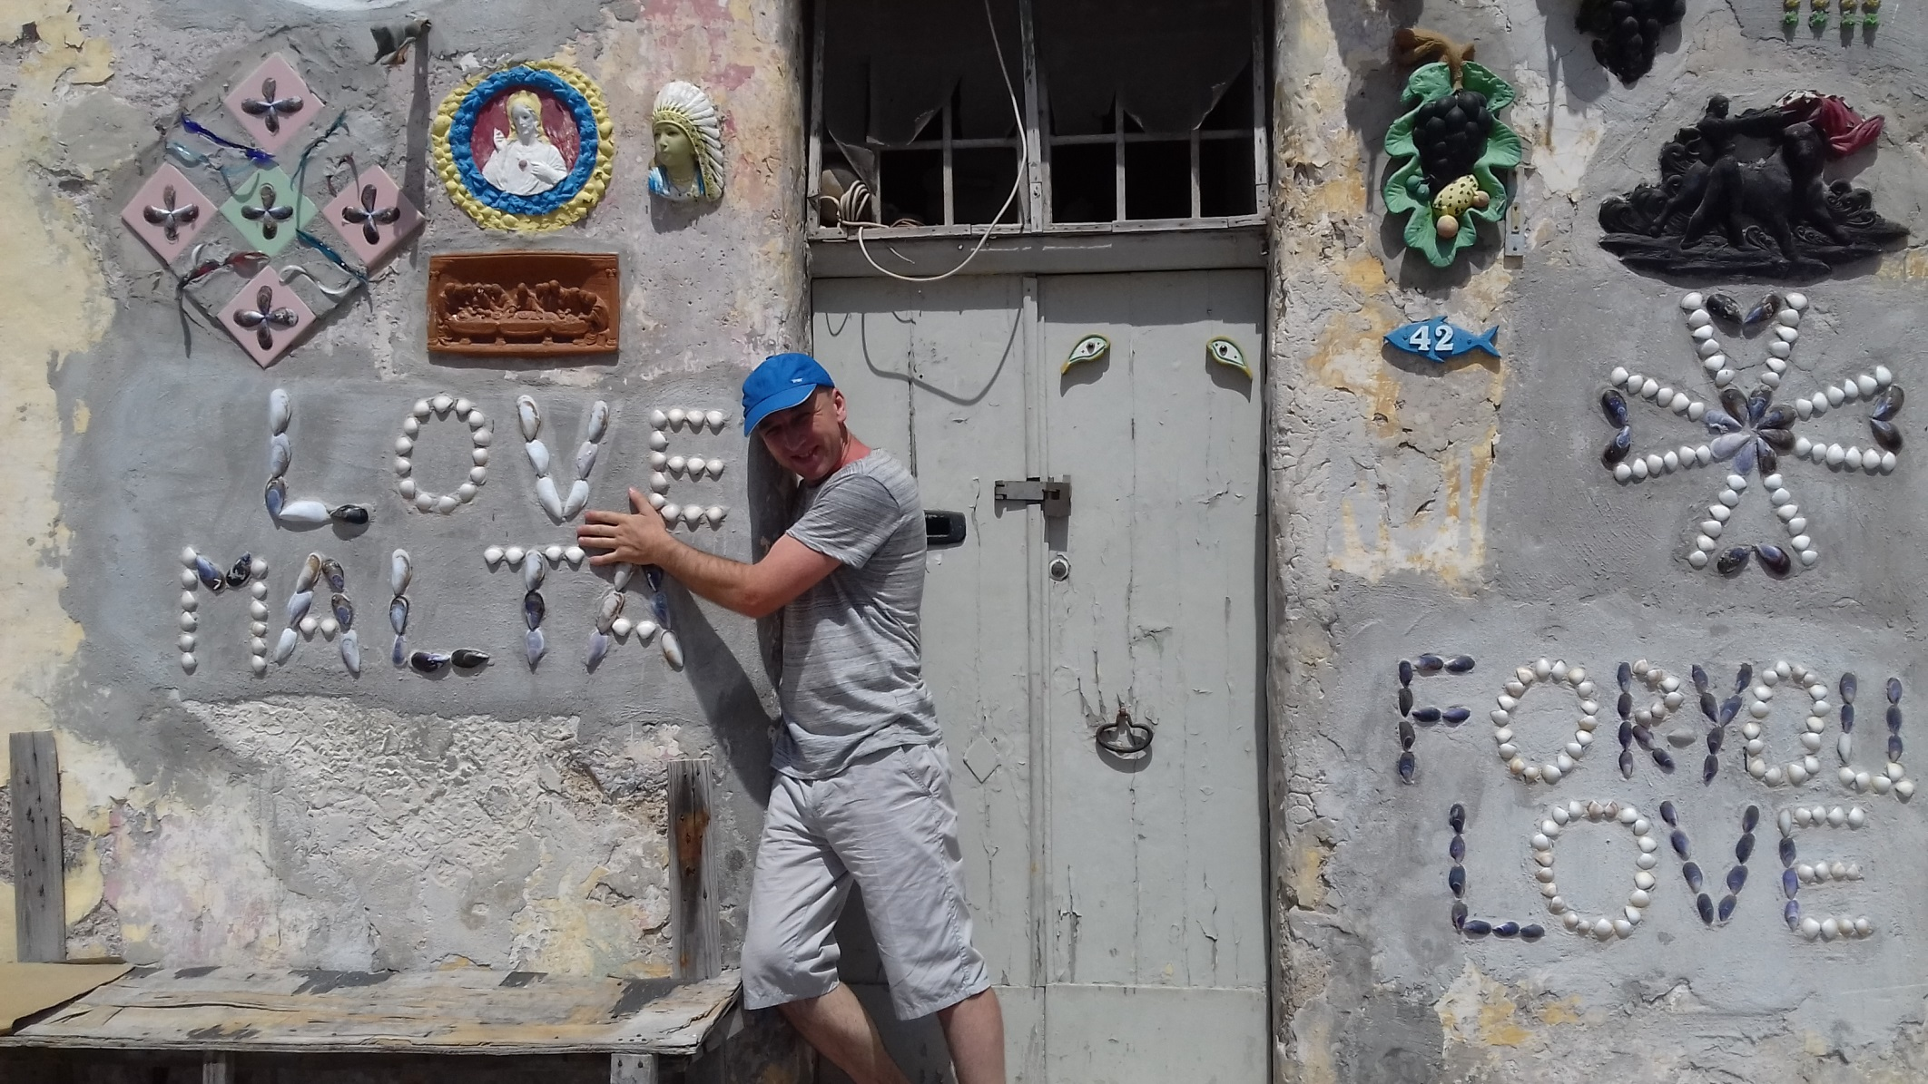
I invite you to Malta!

Slide 2
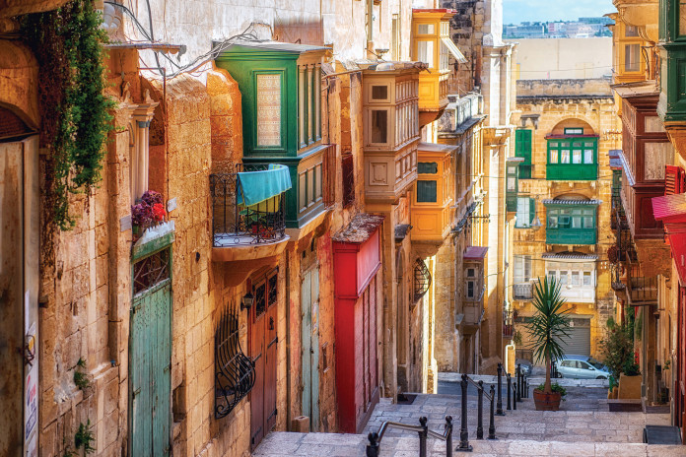
Malta - a mix of cultures
„Mobilność kadry edukacji szkolnej” International High Five for Teachers – together for innovation

Slide 3
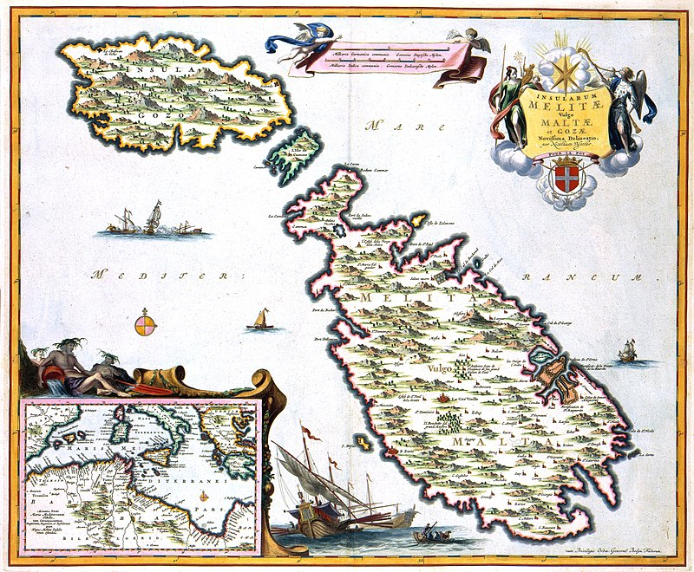
Location of Malta

Slide 5
Czy mówisz po angielsku? Titkellem bl-Ingliż? [titkellem blingliz?]

Slide 6
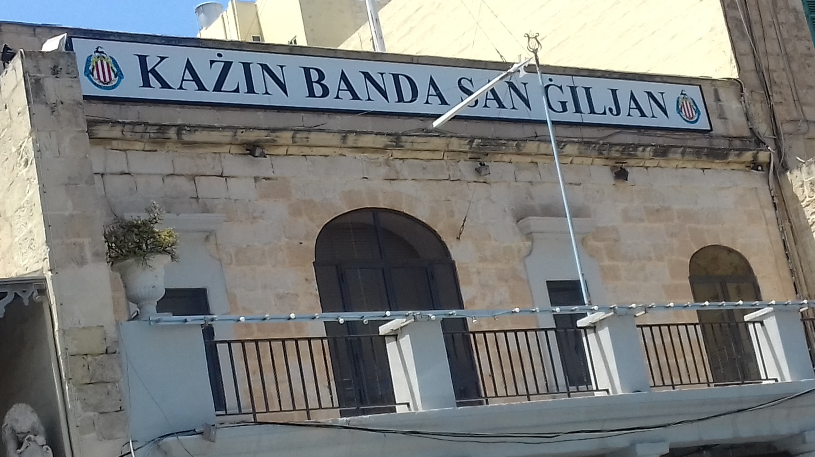

Slide 7
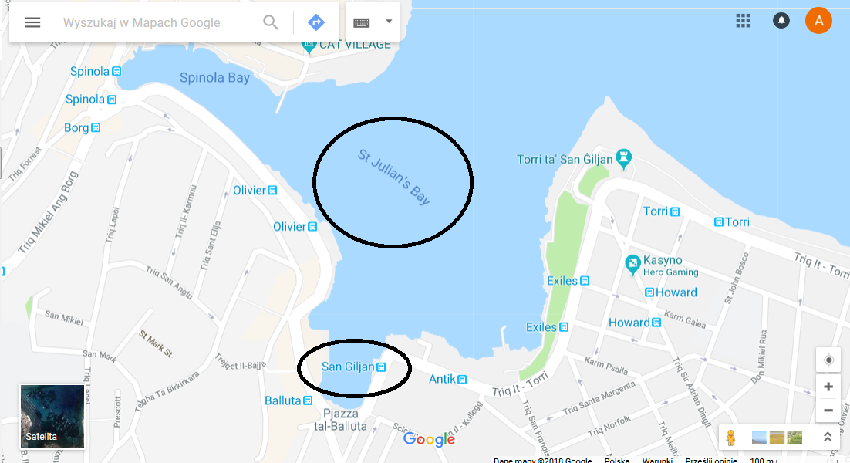

Slide 8
Comparison of English and Maltese

Slide 9
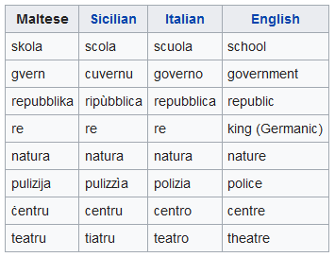
Comparison with other languages

Slide 10
Valletta = La Valetta, Il-Belt, City Rabat = Ir-Rabat Għawdex

Slide 11
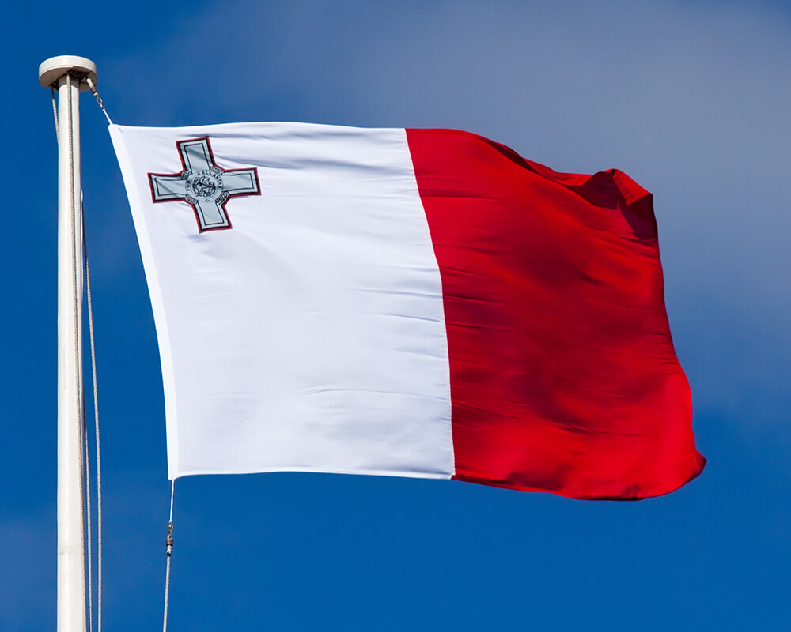
Flag of Malta

Slide 12
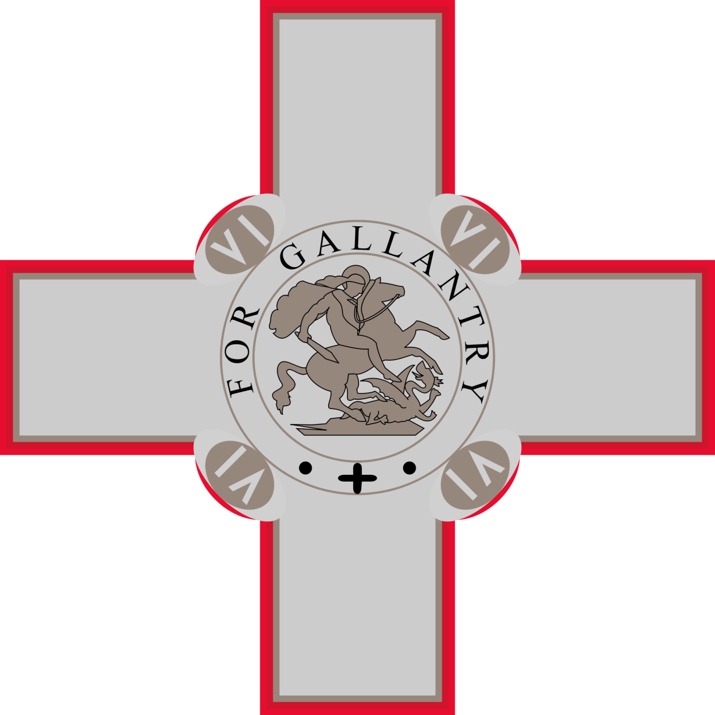
Cross of Saint George

Slide 13
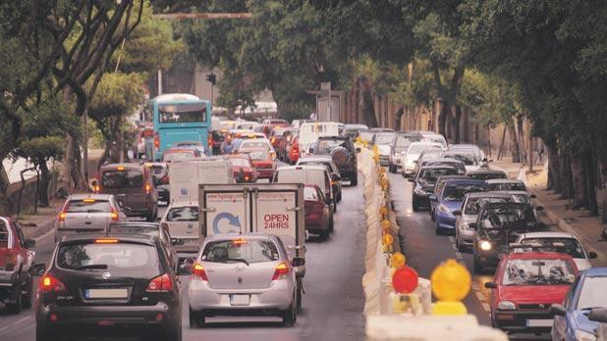
Left-hand traffic

Slide 14
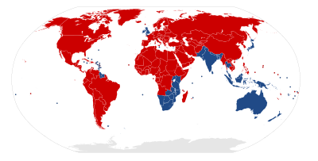
Countries with left-hand traffic

Slide 15
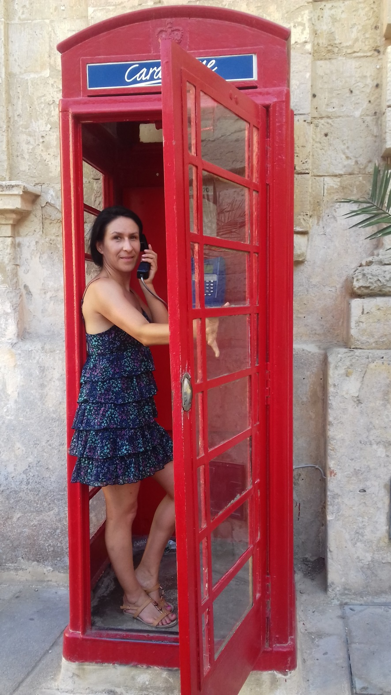
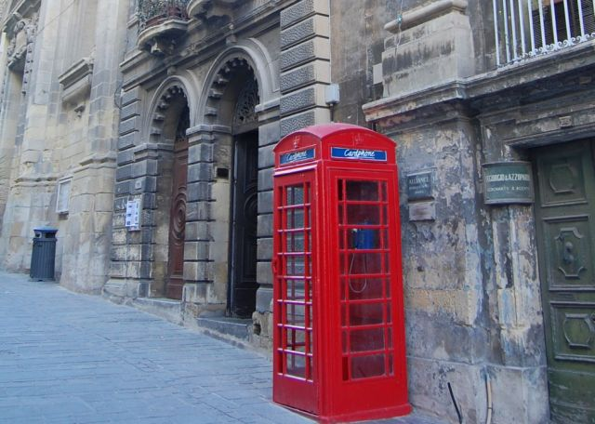
Public phone

Slide 16
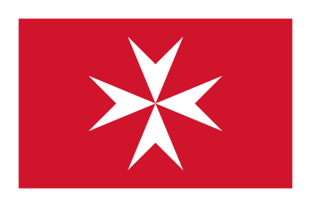
The Maltese cross

Slide 17
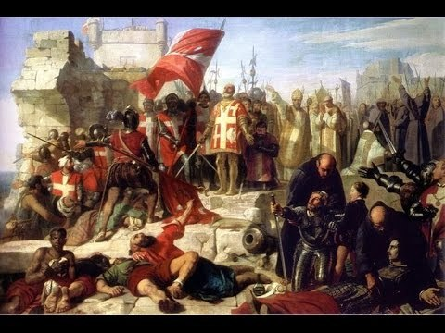
Siege of Malta (1565) Jean Parisot de la Valette (Grand Master of the Order of Saint John)

Slide 18
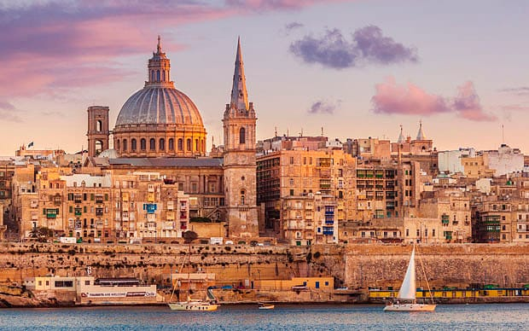
VALETTA

Slide 19
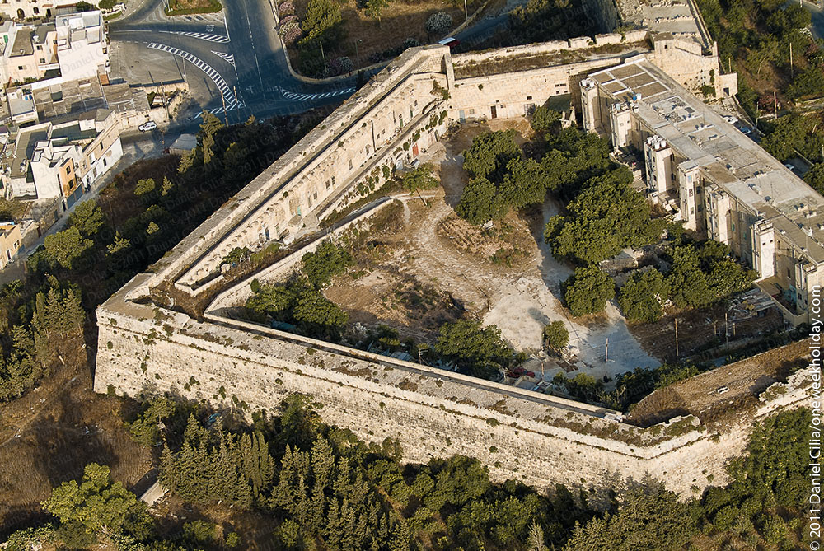
The Cottonera Lines

Slide 20
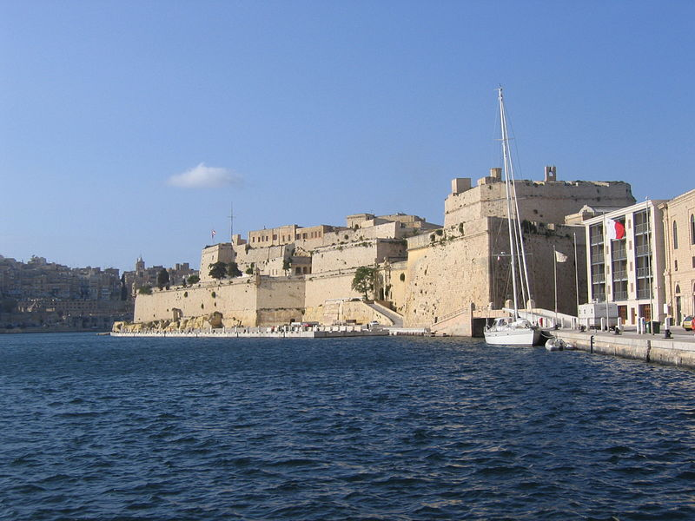
Fort St. Angelo

Slide 21
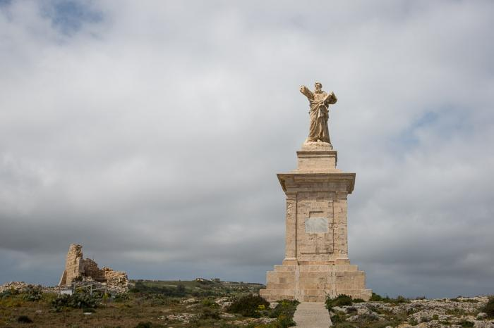
Monument of St. Paul

Slide 22
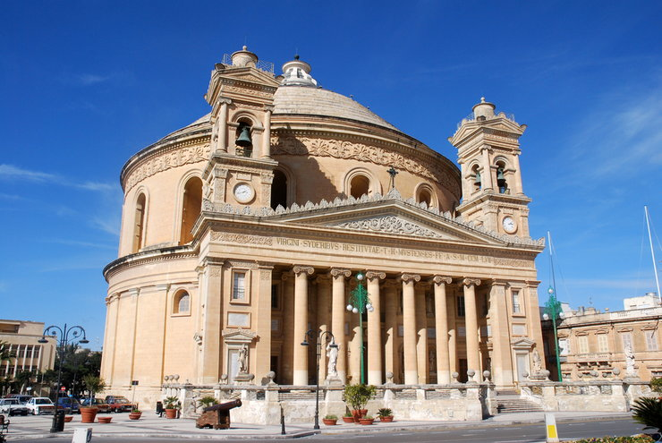
Mosta Dome

Slide 23
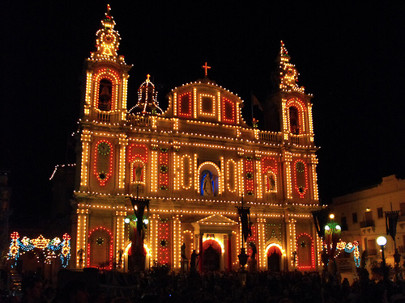
Msida church at night

Slide 24
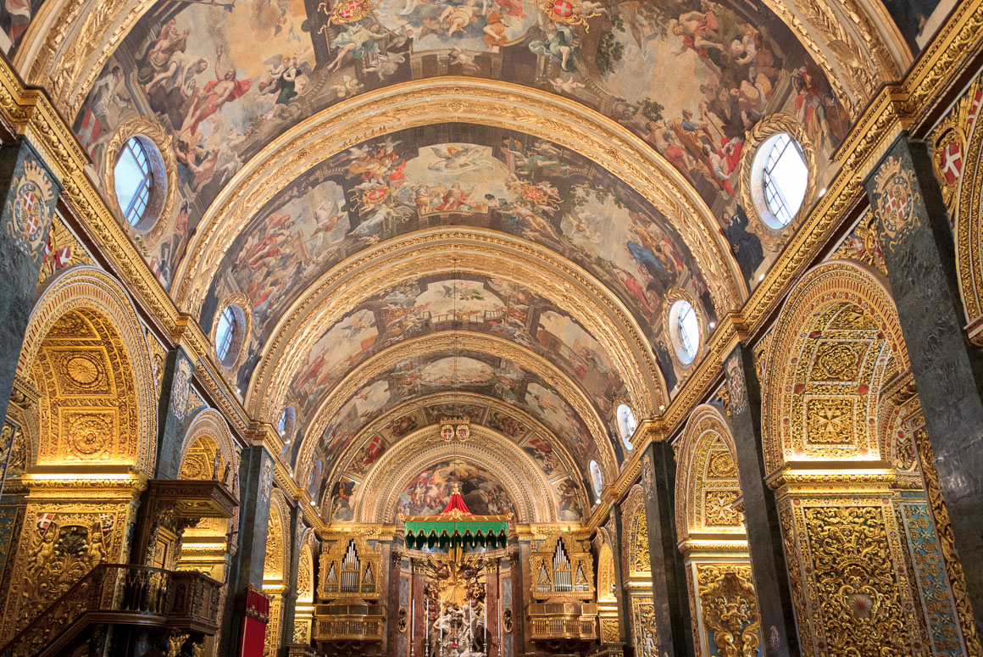
Saint John’s Co-Cathedral

Slide 25
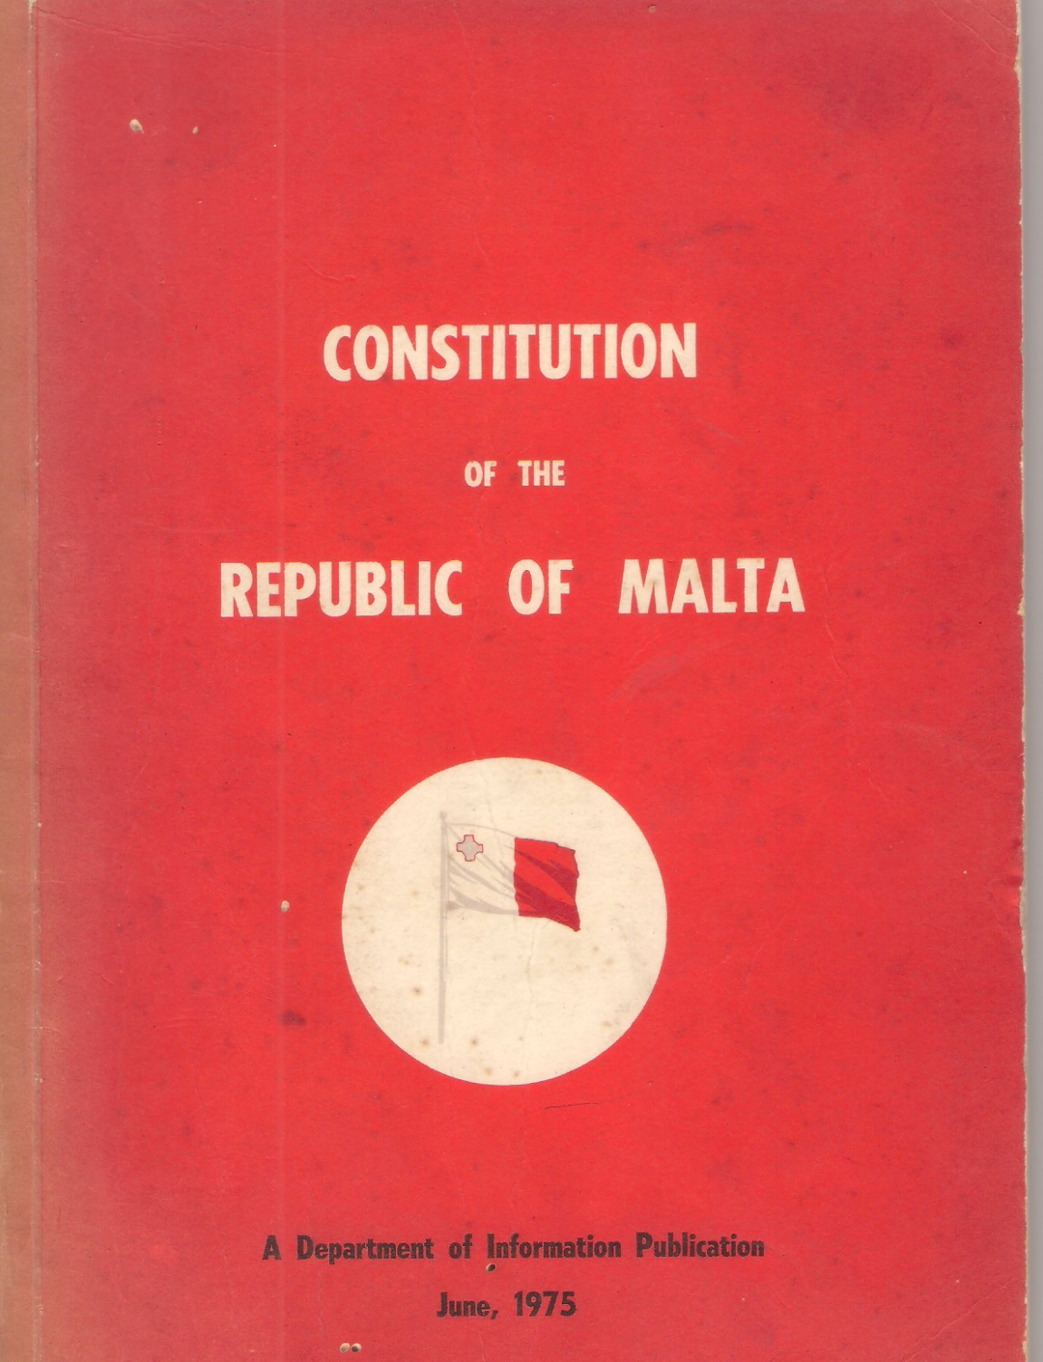
Constitution of the Republic of Malta

Slide 26
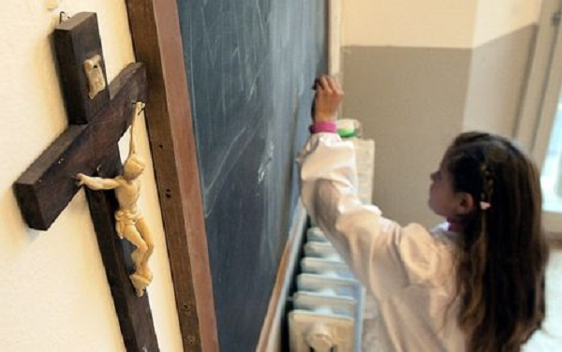
Lessons in Malta

Slide 27
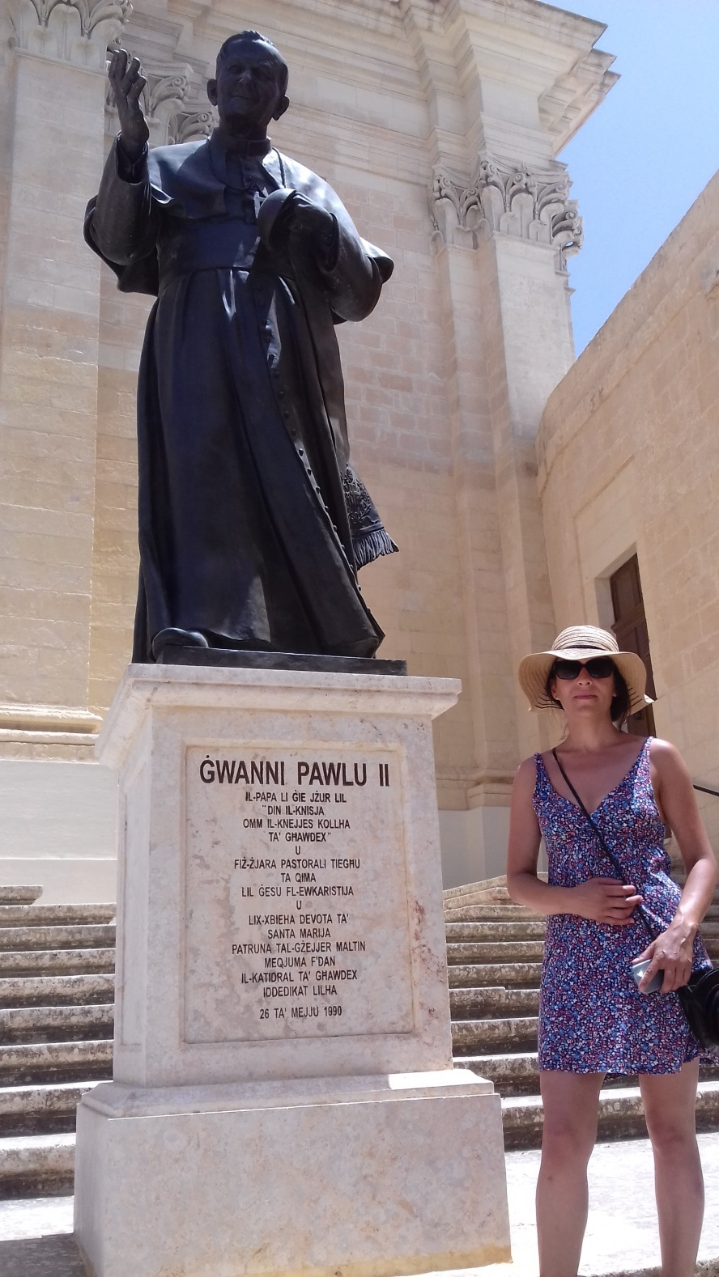
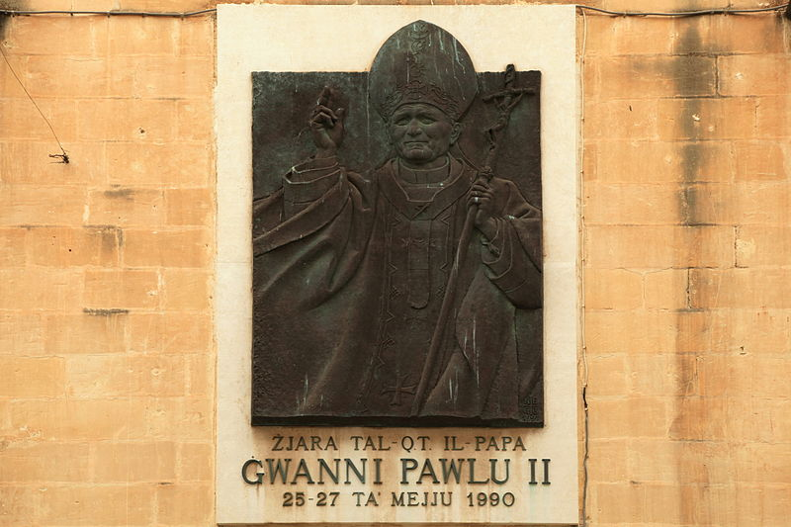
Pope John Paul II

Slide 28
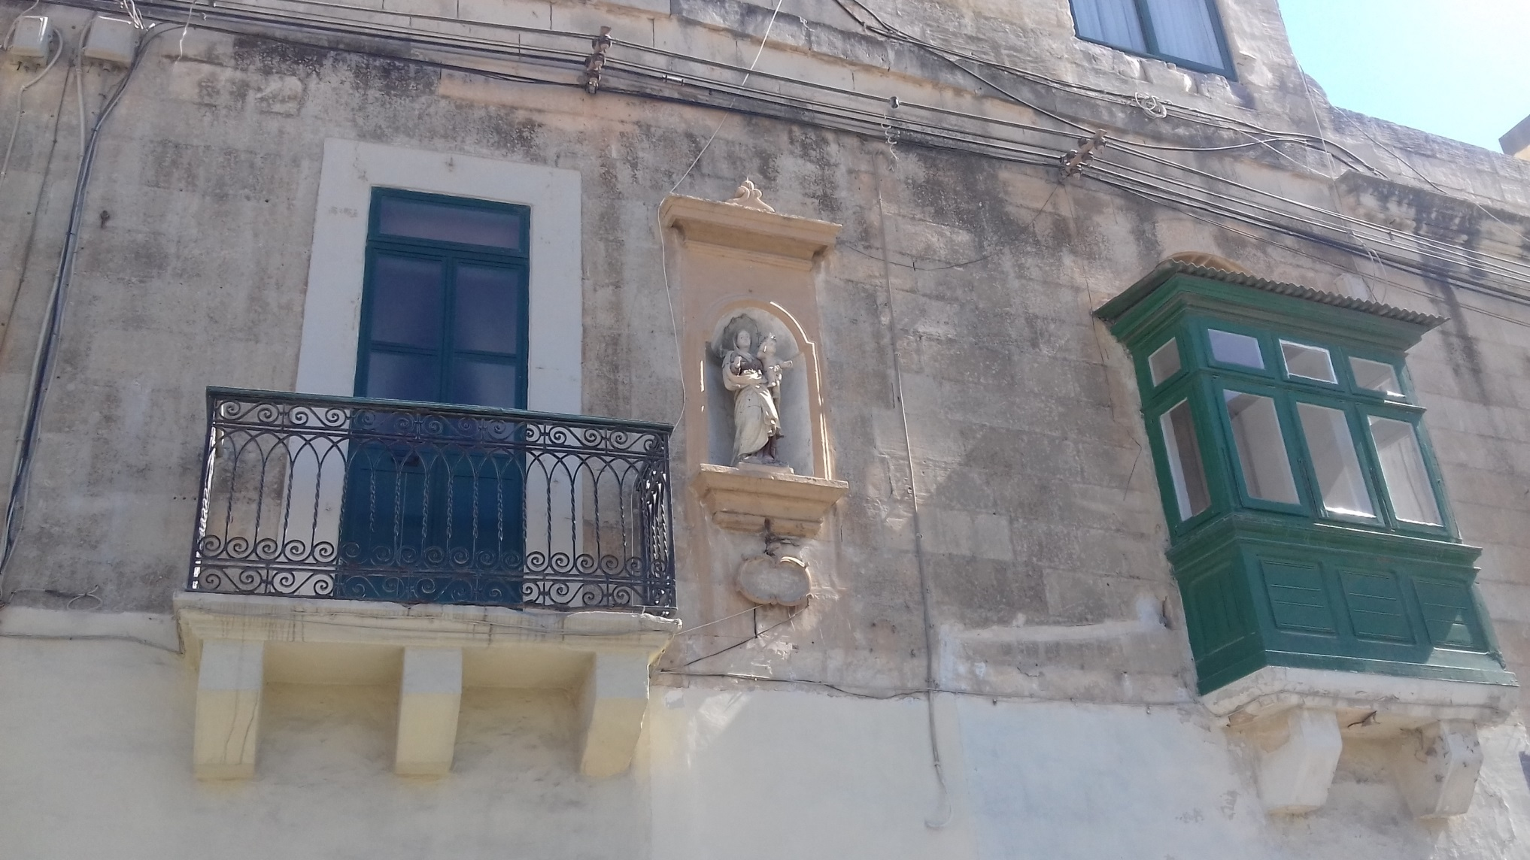
Chapels and bas-reliefs

Slide 29
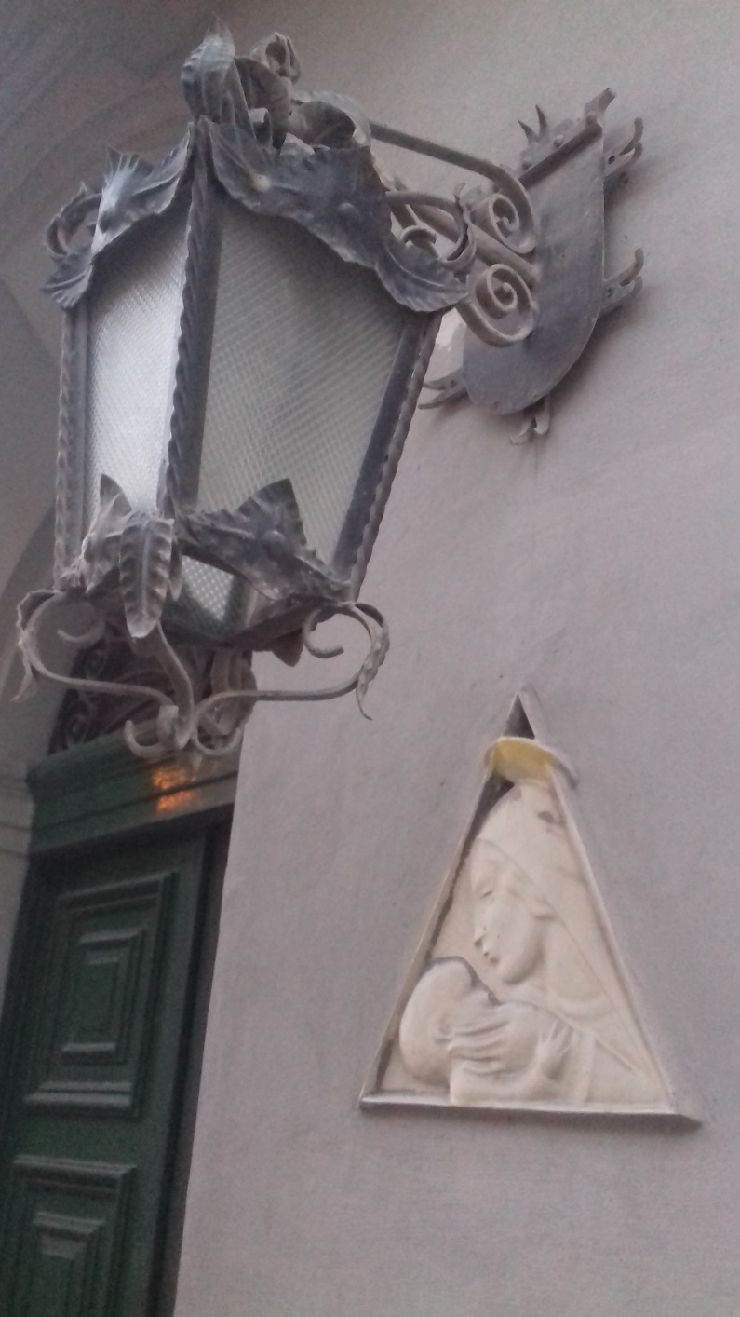
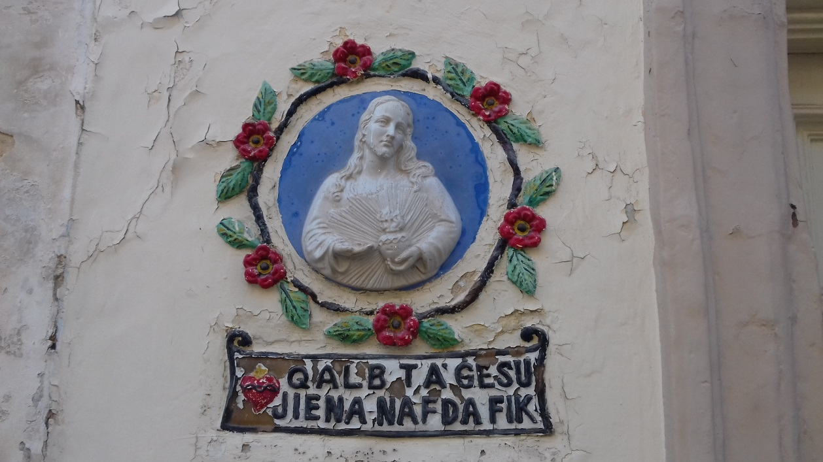
Chapels and bas-reliefs

Slide 30
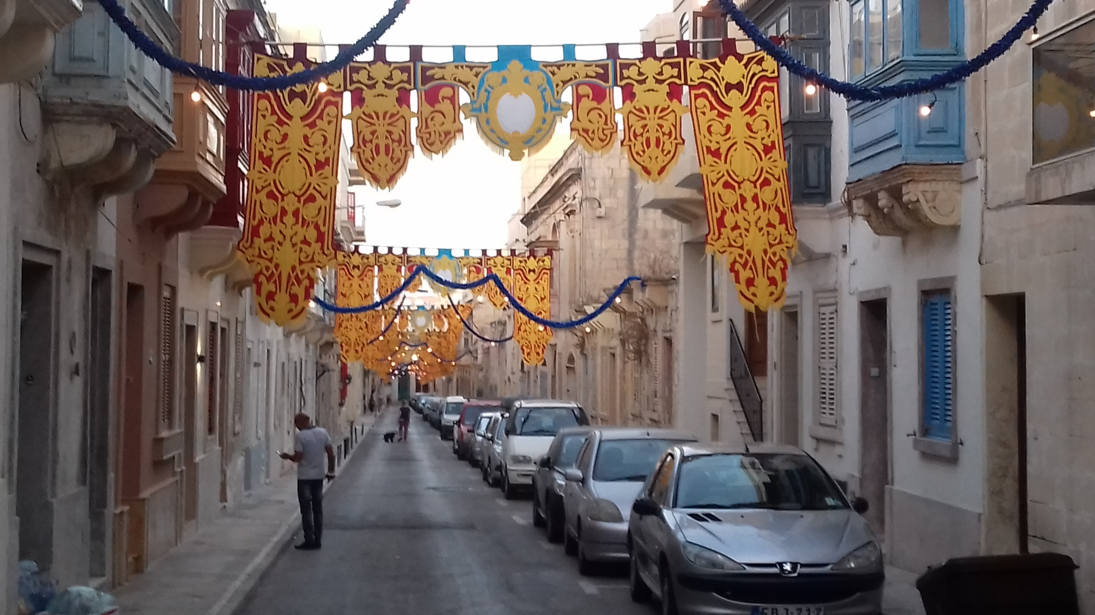
Imnarja – The Feast of St Peter and St Paul

Slide 31
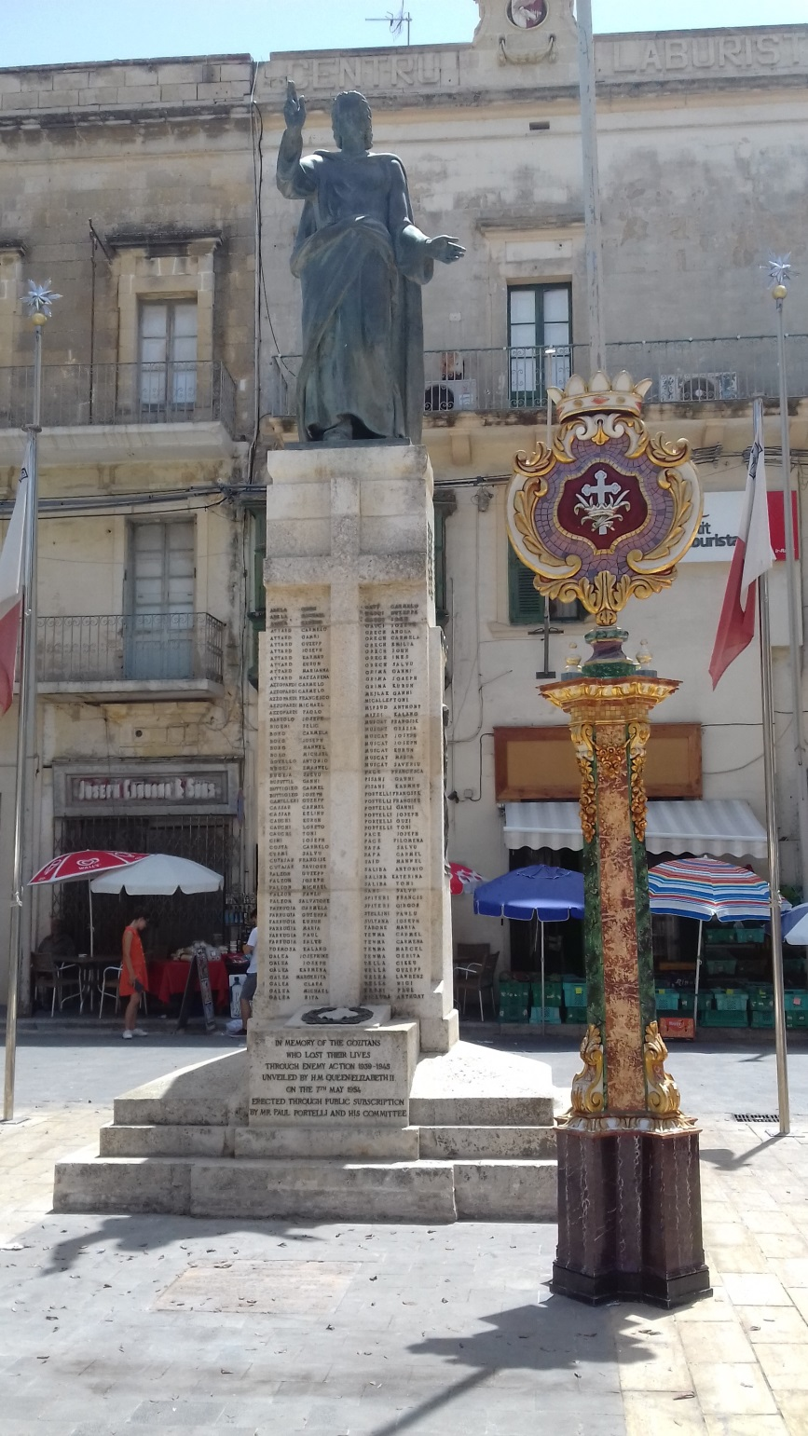
Imnarja – The Feast of St Peter and St Paul

Slide 32
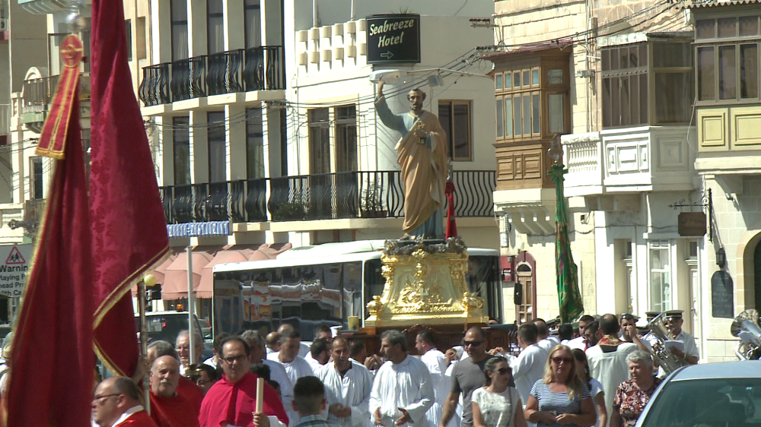
Imnarja – The Feast of St Peter and St Paul

Slide 33
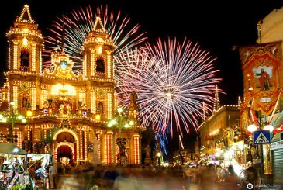
Imnarja – The Feast of St Peter and St Paul

Slide 34
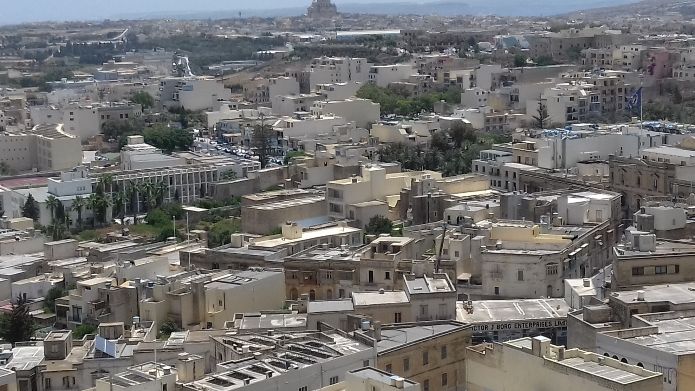
Mdina - old capital

Slide 35
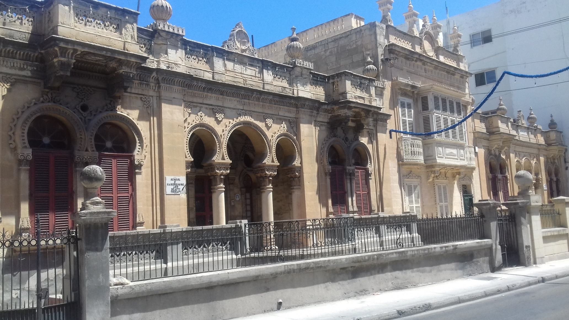
Arabic architecture

Slide 36
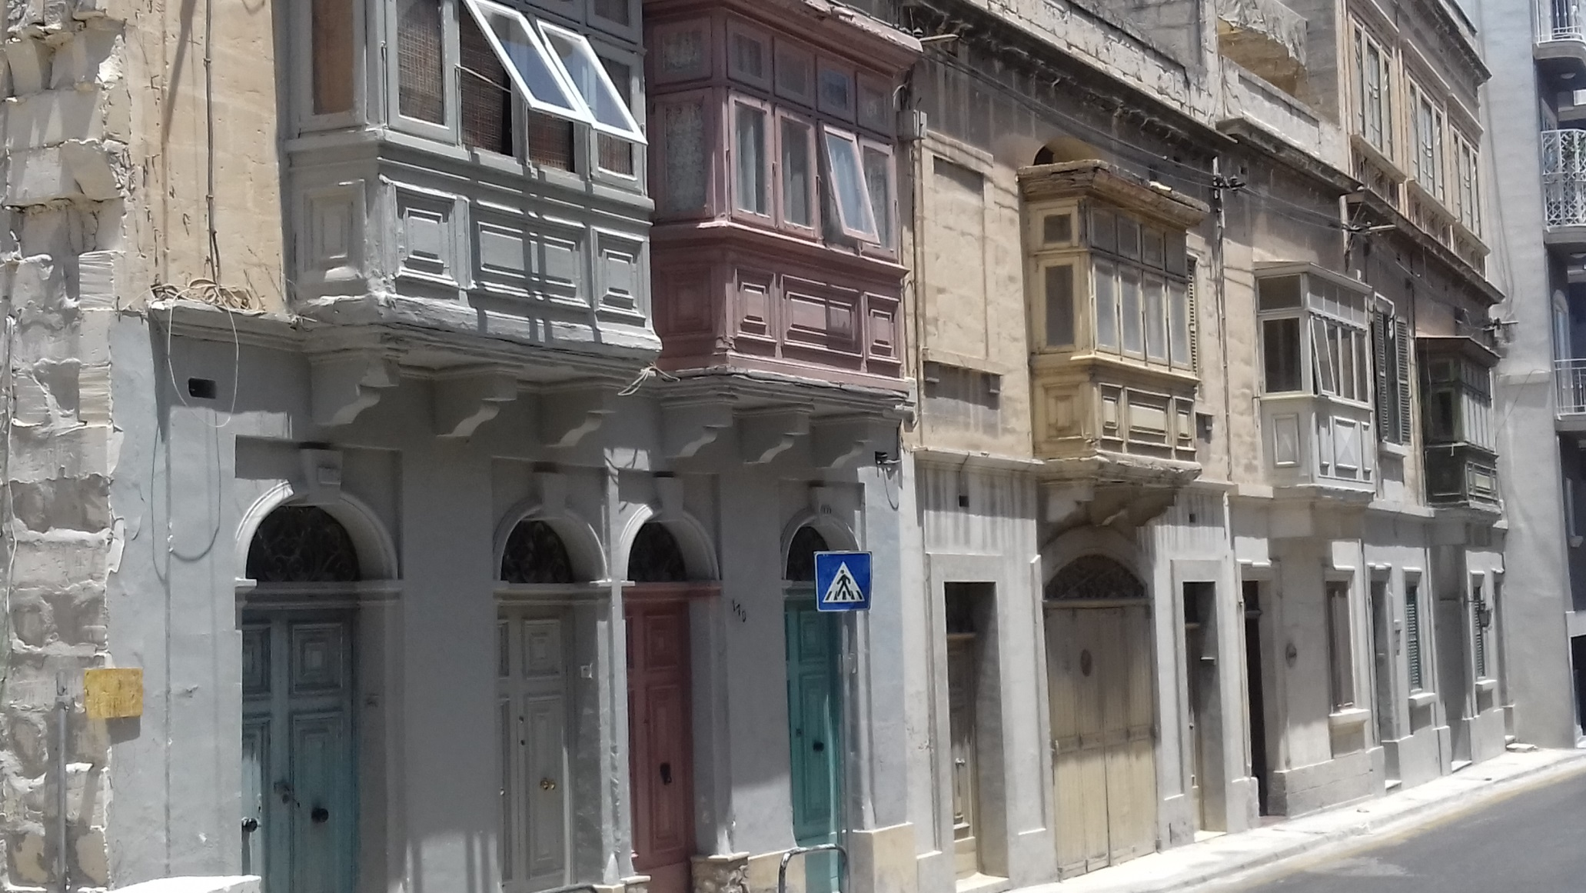
Urban street

Slide 37
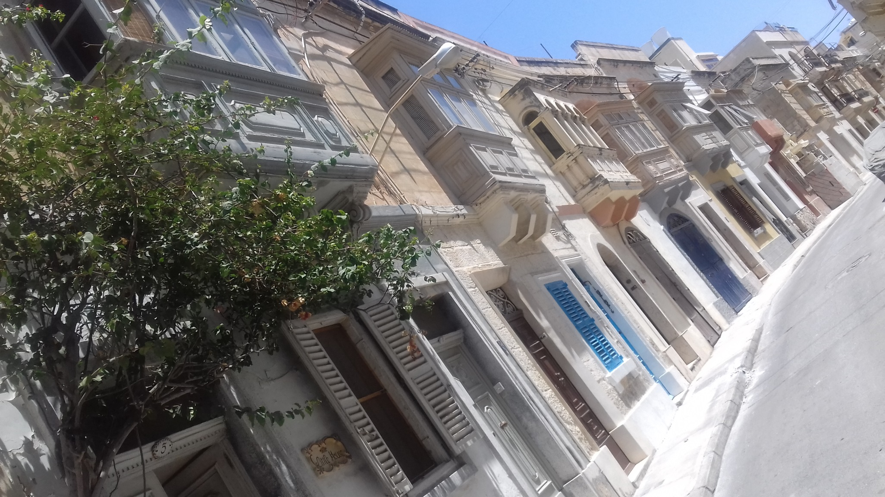
Enclosed wooden balcony

Slide 38
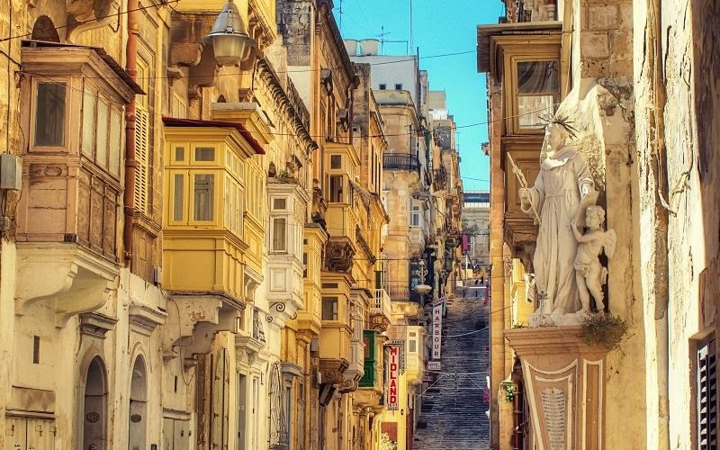
Enclosed wooden balcony

Slide 39
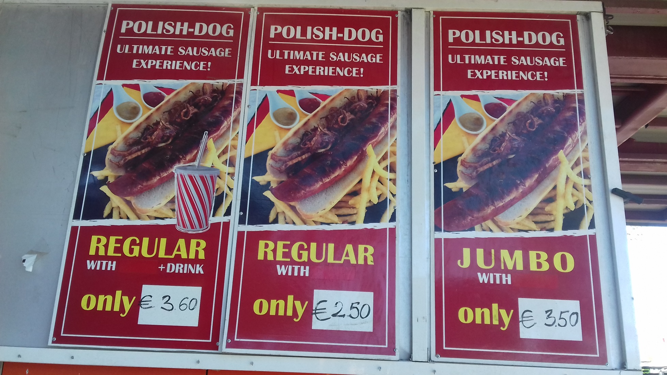
Something polish

